Slide 1
Data Structures and Algorithms

Slide 2
Instructor
Dr Mayuri AVR
Senior Assistant Professor
VIT Bhopal University

Slide 3
Syllabus

Slide 4
Objectives
To understand various types of fundamental data structures (standard and user defined).
To learn about algorithm analysis for the run time complexities and the space requirements.
To acquire knowledge of data structures and algorithms for implementing various real-world problems.

Slide 5
Course Outcomes
CO 1 : Apply the fundamental knowledge of various data structures and algorithms to analyze, design, formulate and implement algorithm for any real time problem.
CO 2 : Apply current techniques in data structures and algorithmic principles for modeling and developing software systems.
CO 3 : Choose an appropriate design paradigm that solves the given problem efficiently along with appropriate data structures.
CO 4 : Map real-world problems to algorithmic solutions.

Slide 6
Modules

Slide 7
Module 1 : Introduction to Algorithm and Data Structures Algorithm
Introduction - Algorithm Design
Complexity- Asymptotic notations.
Data Structures: Introduction
Classification of Data structure
Abstract Data Type (ADT).

Slide 8
Module 2 : Sorting and Searching
Brute force approach: General method
Sorting ( bubble, selection, insertion)
Searching (Sequential/Linear)
Divide and Conquer approach: General method
Sorting ( merge, quick)
Searching (Binary Search)

Slide 9
Module 3 : List, Stack and Queue ADT Linked List
Array Vs Linked List
Singly Linked List
Doubly Linked Lists
Circular Linked Lists-implementation - application
Stack and Queue: Introduction
Implementation (static and dynamic) – application
Circular queues-application.

Slide 10
Module 4: TREES AND HASHING
Linear Vs Non-Linear Data Structures
General Tree – Terminologies
Binary Tree
Expression Tree
Traversals - Binary Search Tree
AVL Tree
Red black Tree
Splay Tree
B Tree.
Hashing: Introduction
Hash Function Methods
Collision Resolution.

Slide 11
Module 5: Graph ADT
Graph Introduction
Representations
Traversals
Topological Sorting
Connected and Bi-Connected Components – Articulation Point
Shortest path algorithms (Dijkstra’s and Floyd’s algorithms)
Minimum spanning tree (Prim’s and Kruskal’s algorithms).

Slide 12
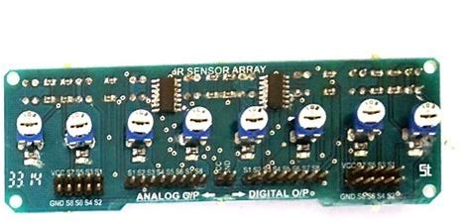
Text & Reference Books
Thomas H. Cormen , Charles E. Leiserson , Ronald L. Rivest , Clifford Stein, Introduction to Algorithms, 3rd Edition, MIT Press, 2009.
Mark A. Weiss,Data Structures and Algorithm Analysis in C++, 4th Edition, Pearson, 2014
Aaron M. Tenenbaum, Yeedidyah Langsam, Moshe J. Augenstein, ‘Data structures using C’, Pearson Education, 2010
D. E. Knuth, Art of computer programming, Volume 1: Fundamental algorithms, Addison Wesley, 2011.

Slide 13
Class Assessment Tutorial – 5 marks Group activity – 5 marks Lab Assessment – 25 marks Attendance – 5 marks Continuous Assessment Test Final Assessment Test
LTP Course

Slide 14
Entry level Questions
Data
Data Vs Information
What do you know about data structure?
Why data structure is needed?

Slide 15
Answer
Data
raw ( attributes / specifics / details / particulars )
Information
data that has been processed
Data Vs Information
What do you know about data structure?
Specialized format to put the data
Why data structure is needed?
Organizing, managing and storing the data to suit the requirements

Slide 16
Data Structure
Store the data in an efficient manner
Retrieve - low cost and less time.
Extract the information for further analysis.
Main purpose of Data structure - organise and store data effectively and efficiently.
Data in organized structure - many advantages
We can easily work
We can also save the resources.

Slide 17
Data Structures
Specific way to store and organize data in computers memory, so that data can be used efficiently in future
Data may be arranged in different ways such as logical model or mathematical model
Data model depends on two factors:
1. Reflect the actual relationships of the data with the real world
2. Simple, so that anyone can efficiently process the data whenever necessary

Slide 18
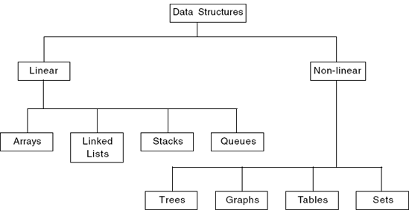
Classification

Slide 19
Non Linear Data Structures
Represents data that contains a hierarchical relationship among various elements
Ex: Trees, Graphs

Slide 20
Linear Data Structures
A data structure is said to be linear if the elements form a sequence
Ways of representing linear data structures in memory
Linear relationship between elements by means of sequential memory locations
Ex: ARRAY
Linear relationships between elements by means of links
Ex: LINKED LIST

Slide 21

Recap

Slide 22
Thank You

